Slide 1
MIMD Processors
P. K. Roy
Siliguri Institute of Technology

Slide 2
Introduction
A set of general purpose processors is connected together.
In contrast to SIMD processors, MIMD processors can execute
different programs on different processors => Flexibility!
MIMD processors works asynchronously, and don’t have to
synchronize with each other.
By 90s, SIMD lost ground, since general purpose microprocessors are now very cheap and powerful.
MIMD machines could be built from commodity (off-the-shelf) microprocessors with relatively little effort.
MIMD architectures can be highly scalable, if an appropriate
memory organization is used.

Slide 3
SIMD vs MIMD
SIMD computers require less hardware than MIMD computers
(single control unit).
However, SIMD processors are specially designed, and tend to be expensive and have long design cycles.
Not all applications are naturally suited to SIMD processors.
Conceptually, MIMD computers cover SIMD need.
- Having all processors executing the same program(single
program multiple data streams - SPMD).
- SPMD avoids the complexity of general concurrent programming.

Slide 4
MIMD Processor Classification(1)
Tightly coupled system generally represent systems which have some degree of sharable memory through which processors can exchange information with normal load / store operations
Ex. Multiprocessor
Loosely coupled systems generally represent systems in which each processor has its own private memory and processor to processor information exchange is done via some message passing mechanism like a network interconnect or an external shared channel (FC, IB, SCSI, etc.) bus
Ex. Multicomputer

Slide 5
MIMD Processor Classification(2)
Centralized Memory: Shared memory located at centralized location - consisting usually of several interleaved modules - the same distance from any processor.
- Symmetric Multiprocessor (SMP)
- Uniform Memory Access (UMA)
Distributed Memory: Memory is distributed to each processor
- improving scalability.
Message Passing Architectures: No processor can directly access another processor’s memory.
Hardware Distributed Shared Memory (DSM): Memory is distributed, but the address space is shared.
- Non-Uniform Memory Access (NUMA)
Software DSM: A level of OS built on top of message passing multiprocessor to give a shared memory view to the programmer.

Slide 6
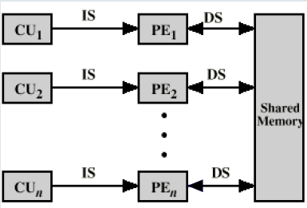
MIMD with Shared Memory
Tightly coupled, not scalable.
Typically called Multi-processor.

Slide 7
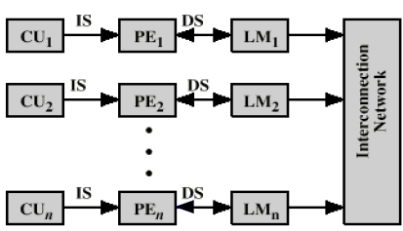
MIMD with Distributed Memory
Loosely coupled with message passing, scalable
Typically called Multi-computer.

Slide 8
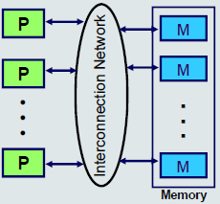
Shared-Address-Space Platforms
Part (or all) of the memory is accessible to all processors.
Processors interact by modifying data objects stored in this shared-address-space.
UMA (uniform memory
access) = the time
taken by a processor to
access any memory
word in the system is
identical.
NUMA, otherwise.

Slide 9
Multi-Computer Systems(1)
A multi-computer system is a collection of computers
interconnected by a message-passing network.
- Clusters.
Each processor is an autonomous computer
- With its own local memory.
- There is no a shared-address-space any longer.
- They communicating with each other through the message
passing network.
Can be easily built with commodity microprocessors.

Slide 10
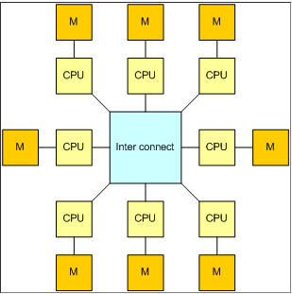
Multi-Computer Systems(2)
The processor and memory pairs are connected to a fast high speed interconnect.
The system is also called message passing multicomputer.
Implementation is much simpler than the memory shared multiprocessor.
Accessing a memory word takes about 10-50 µsec.

Slide 11
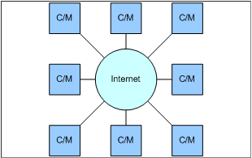
Wide area distributed system
This system connects complete computer systems over a wide area network, such as Internet. It forms a distributed system. Since the accessing is rather slow the systems are loosely coupled.
Accessing a memory word takes about 10'000-100'000 µsec.

Slide 12
Symmetric Multiprocessors (SMP)
A set of similar processors of comparable capacity.
All processors can perform the same functions (symmetric).
Processors are connected by a bus or other internal connection.
Processors share the same memory.
- A single memory or a pool of memory modules
Memory access time is (approximately) the same for each
processor.
All processors share access to I/O.
- Either through the same channels or different channels
giving paths to the same devices
Controlled by an integrated operating system:
- Providing interaction between processors
- Interaction at job, task, file and data element levels

Slide 13
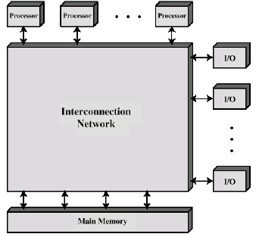
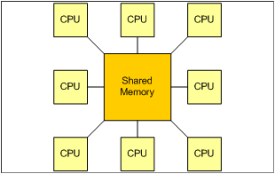
Symmetric Multiprocessors (SMP)
Shared-memory multiprocessor.
This system is invisible to the programmer. The message passing is done under
cover. The implementation is not very easy, and there are some limits as well.
Accessing a memory word takes about 0.002-0.01 µsec.

Slide 14
SMP Advantages
High performance
- If similar work can be done in parallel (e.g., scientific computing).
Good availability
- Since all processors can perform the same functions, failure of a single
processor does not stop the system.
Support incremental growth
- Users can enhance performance by adding additional processors.
Scaling
- Vendors can offer range of products based on different number of
processors.

Slide 15
Interconnection Network
Time-shared common bus
Multiport Memory
Crossbar Switch
Multi-stage Switching Network
Hypercube System

Slide 16
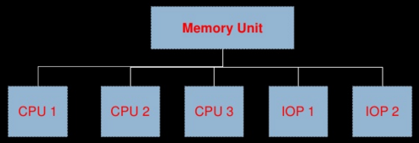
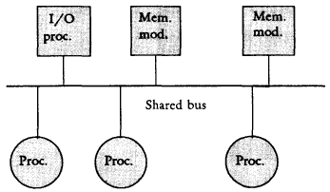
Time-shared Common Bus
Common bus is used for interconnection.

Slide 17
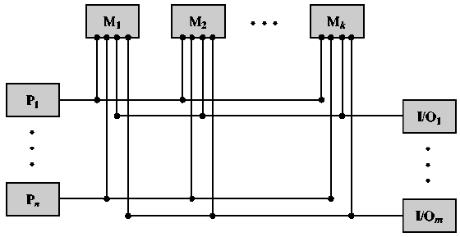
Multiport Memory
Separate buses between each memory module & each processor

Slide 18
Crossbar Switch(1)
The simplest circuit for connecting n CPUs to k memories is the crossbar switch. Crossbar switches have long been used in telephone switches.
At each intersection is a cross-point - a switch that can be opened or closed.
The crossbar is a non-blocking network

Slide 19
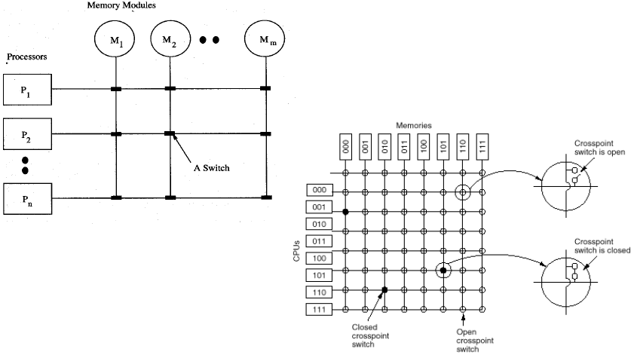
Crossbar Switch(2)

Slide 20
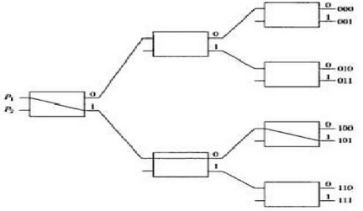
Multi-stage Switching Network(1)
Use of 2 i/p and 2 o/p interchange switch(2x2 crossbar)

Slide 21
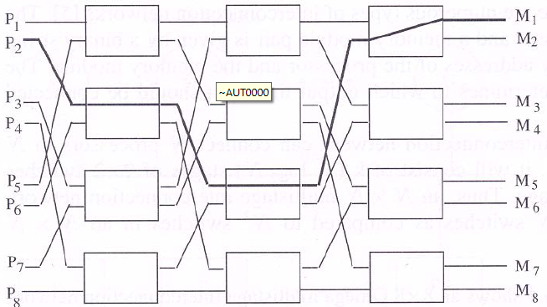
Multi-stage Switching Network(2)

Slide 22
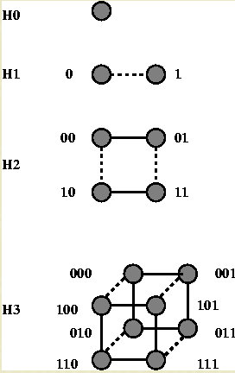
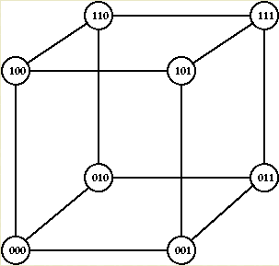
Hypercube System
A k-dimensional hypercube
contains 2^{k} processors (nodes).
Each processing node contains
a switch.
Mostly in Multicomputer System

Slide 23
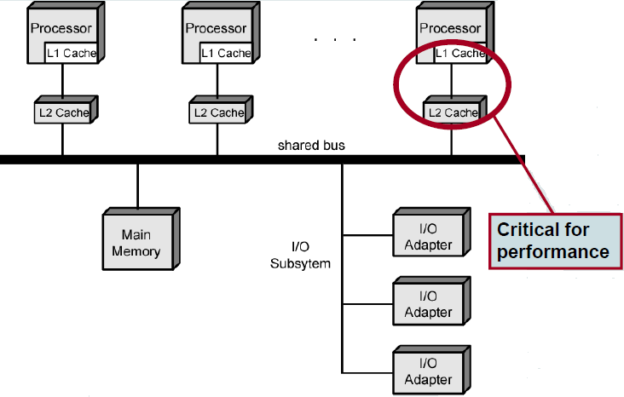
SMP based on Shared Bus

Slide 24
Shared Bus – Pros and Cons
Advantages:
- Simplicity.
- Flexibility - Easy to expand the system by attaching
more processors.
Disadvantages:
- Performance limited by bus bandwidth.
- Each processor should have local cache
• To reduce number of bus accesses
• Can lead to problems with cache coherence
- Should be solved in hardware (to be discussed later).

Slide 25
Operating System Issues
An SMP OS manages processor resources so that the user perceives a single system.
It should appear as a single-processor multiprogramming system.
In both SMP and uniprocessor, multiple processes may be active at one time.
- OS is responsible for scheduling their execution and
allocating resources.
A user may construct applications that use multiple processes without regard to whether a single processor or multiple processors will be available.
OS supports reliability and fault tolerance.
- Graceful degradation.

Slide 26
MIMD Design Issues
Design issues related to an MIMD machine are very complex,
since it involves both architecture and software issues.
The most important issues include:
- Processor design
- Physical organization
- Interconnection structure
- Inter-processor communication protocols
- Memory hierarchy
- Cache organization and coherency
- Operating system design
- Parallel programming languages
- Application software techniques

Slide 27
Memory Access Issues
Uniform memory access (UMA), as in SMP:
- All processors have access to all parts of memory.
- Access time to all regions of memory is the same.
- Access time for different processors is the same.
Non-uniform memory access (NUMA)
- All processors have access to all parts of memory.
- Access time of processor differs depending on region of
memory.
- Different processors access different regions of memory at
different speeds.
No Remote Access or NORMA systems
- Distributed systems
Ref: Karsuk

Slide 28
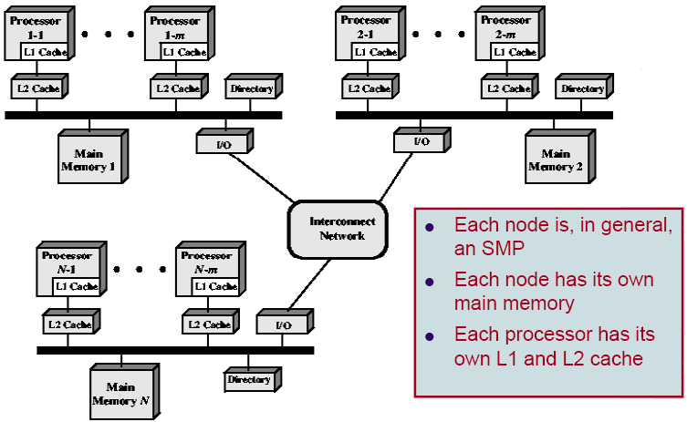
A Typical NUMA Organization(1)

Slide 29
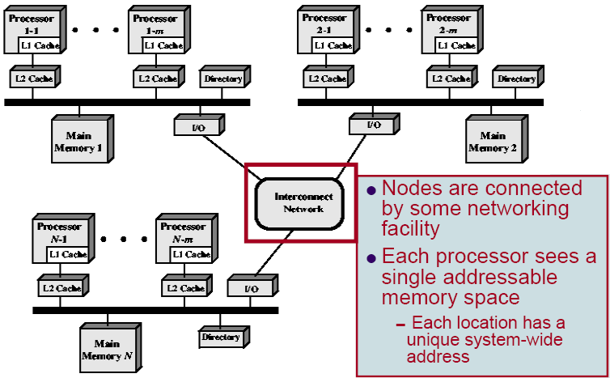
A Typical NUMA Organization(2)

Slide 30
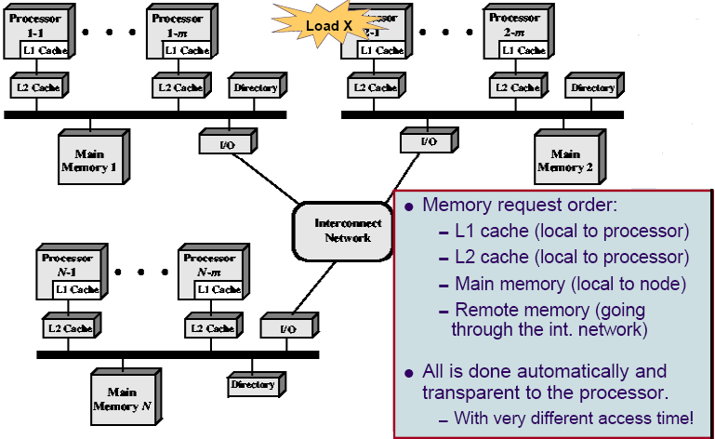
A Typical NUMA Organization(3)

Slide 31
NUMA-Pros and Cons
Effective performance at higher levels of parallelism than SMP.
However, performance can break down if too much access to remote memory. This can be avoided by:
- Designing better L1 and L2 caches to reduce memory access.
• Need also good temporal locality of software.
- If software has good spatial locality, data needed for an application
will reside on a small number of frequently used pages.
• They can be initially loaded into the local memory.
- Enhancing VM by including in OS a page migration mechanism to
move a VM page to a node that is frequently using it.
NUMA does not transparently look like a SMP.
- Software changes needed to move OS and applications from SMP to
NUMA.
- Page allocation, process allocation and load balancing are needed.

Slide 32
Loosely Coupled MIMD - Clusters
Cluster: A set of computers connected over a high-bandwidth local area network, and used as a parallel computer.
- A group of interconnected stand-alone computers
- Work together as a unified resource
- Give illusion of being one machine
- Each computer called a node
- A node can also be a multiprocessor itself, such as an SMP.
- Message passing for communication between nodes
- NOW: Network of Workstations, homogeneous cluster.
- Grid: Computers connected over a wide area network.

Slide 33
Cluster Benefits
Absolute scalability
- Cluster with a very large number of nodes is possible.
Incremental scalability
- A user can start with a small system and expand it as needed,
without having to go through a major upgrade.
High availability
- Fault tolerance by nature.
Superior price/performance
- Can be built with cheap commodity nodes.
Supercomputing-class commodity components are available
The promise of supercomputing to the average PC User?

Slide 34
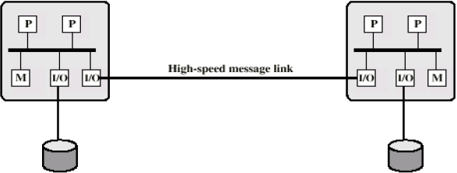
Cluster Configurations(1)
The simplest classification of clusters is based on whether the nodes share access to disks.
Cluster with no shared disk.
- Interconnection is by high-speed link
- LAN may be shared with other non-cluster computers
- Dedicated interconnection facility

Slide 35
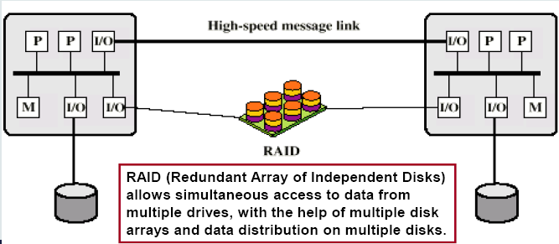
Cluster Configurations(2)
Shared-disk cluster
- Still connected by a message link
- Disk subsystem directly linked to multiple computers
- Disks should be made fault-tolerant
To avoid single point of failure in the system.

Slide 36
Parallelizing Computation
How to make a single application executing in parallel on a cluster:
Paralleling complier
- Determines at compile time which parts can be executed in parallel.
Parallelized application
- Application written from scratch to be parallel.
- Message passing to move data between nodes.
- Hard to program.
- Best end results.
Parametric computing
- If a problem is repeated execution of algorithm on different sets of
data.
e.g. simulation using different scenarios.
- Needs effective tools to organize and run.

Slide 37
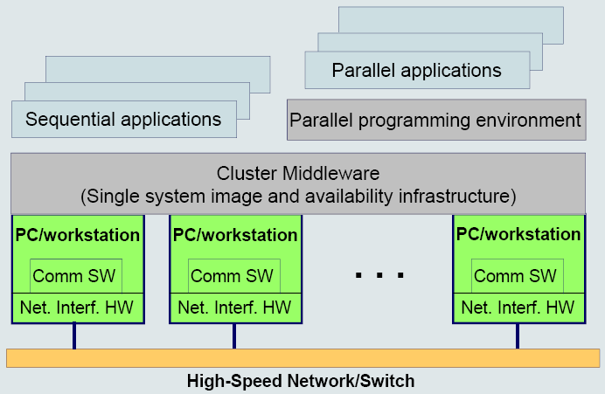
Cluster Computer Architecture

Slide 38
Cluster vs. SMP
Both provide multiprocessor support to high demand applications.
Both available commercially
- SMP for longer time
SMP:
- Easier to manage and control
- Closer to single processor systems
- Scheduling is the main difference
- Less physical space
- Lower power consumption
Clustering:
- Superior incremental and absolute scalability
- Superior availability
- High degree of redundancy

Slide 39
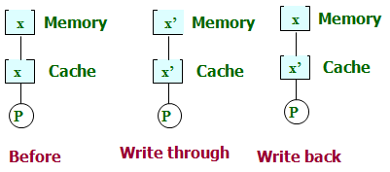
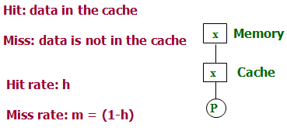
Cache coherence(1)
Single Processor caching
Cache Coherence Policies

Slide 40
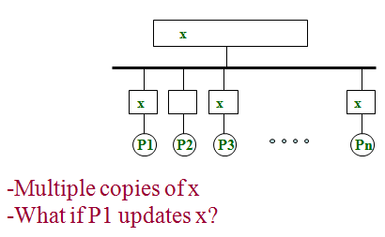
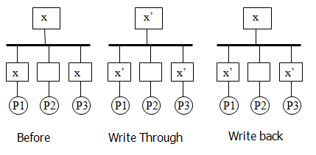
Cache coherence(2)

Slide 41
References:
Advanced Computer Architecture –Kai Hwang
Advanced Computer Architecture –Karsuk
Computer System Architecture - Mano

